Slide 1

Is beautiful really usable? Toward understanding the relation between usability, aesthetics, and affect in HCI
Tuch et al., 2012

Slide 2
Introduction
Aesthetics is one of the most frequently researched dimensions in studies of UX
Influence of aesthetics on
Trust and credibility
Perception of usability
Usability testing
Overall impression
Purpose: Understand the relation between aesthetics and usability.
Notes:
HCI 분야에서 특히 UX 연구에는 aesthetic (미적) 연구가 활발하게 진행되었다. 많은 연구는 aesthetic가 (First bullet list)에 어떤 영향을 주는지 보았다. 몇몇 연구들은 Usability-Aesthetic의 상호작용을 지지하였지만 다른 연구들은 이 관계를 찾지 못 했다. 그 이유는 대부분 연구들은 correlative study 형식으로 진행되었기 때문이라고 하였다. 따라서 본 연구는 usability 와 aesthetics를 통제하여 experimental study를 진행했다.

Slide 3
What is beautiful is usable (Correlative)
Notes:
대부분의 correlative 연구의 방법론은 참여자가 어떤 제품을 사용하기 전/후의 perceived usability 와 perceived aesthetics을 측정하는 방법으로 이루어 졌다.

Slide 4
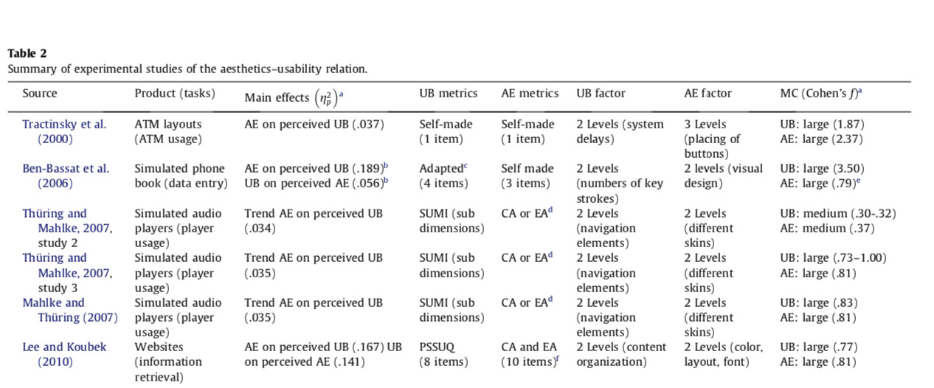
What is beautiful is usable (Experimental)
Notes:
Experimental 연구 중에 대표적인 Tractinsky et al. 연구는 ATM interface의 beauty가 사용자의 usability

Slide 5
Shortcomings of previous research
Manipulation of aesthetics and usability
Difficulty of systematic and independent manipulation of aesthetics and usability
Assessment of aesthetics and usability
Use of validated and un-validated scales across studies
Notes:
The current study aims to address some of these issues
Independently manipulate aesthetics and usability
Use several validated scales.

Slide 6
Hypotheses
H1: Interface-aesthetics affects perceived suability before usage
H2: Interface-aesthetics affects perceived suability after usage
H3: Interface-usability affects perceived aesthetics after usage

Slide 7
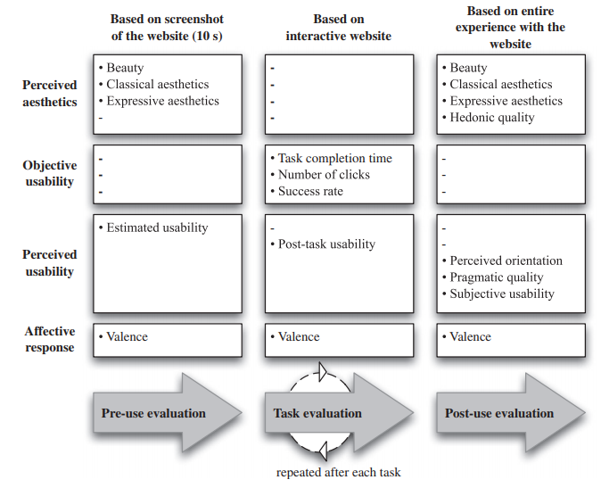
Methods
Three-factor, mixed design
Between subjects
IV: 1) Interface-usability (Low vs. high usability)
2) Interface-aesthetics (Low vs. high aesthetics)
Within Subjects
IV: Time (Pre-use vs. Post-use)
Primary dependent variable
Perceived usability
Perceived aesthetics

Slide 8
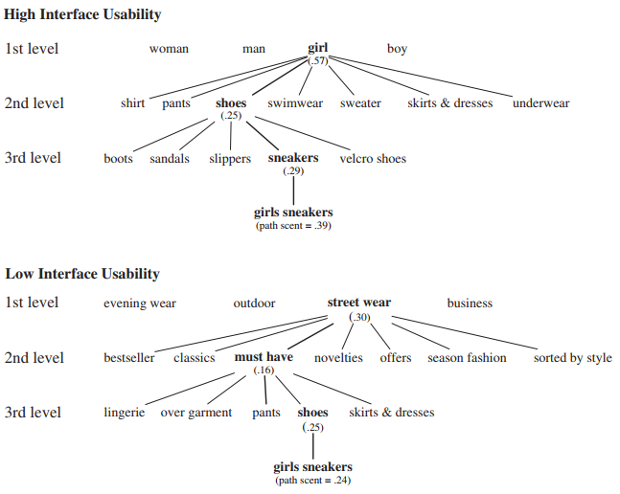
Interface-usability

Slide 9
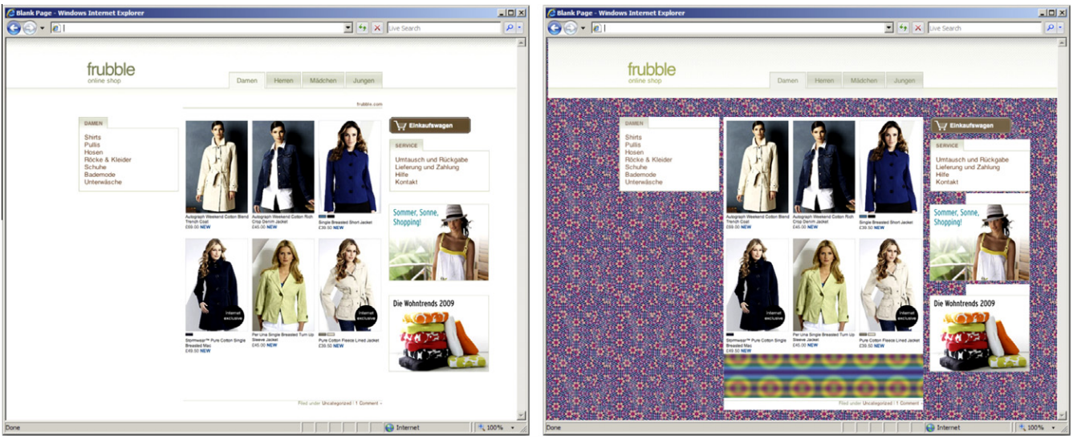
Interface-aesthetics

Slide 10
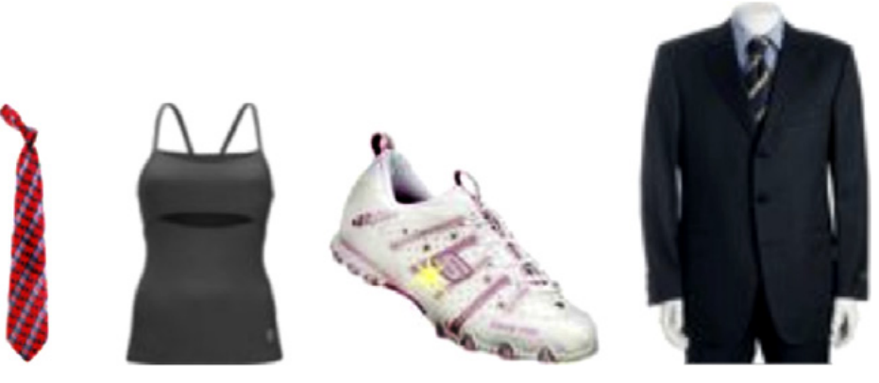
Tasks

